Slide 1

Fireproof Your Computer from Jenny Bryan
R Projects and here::here()
Kat Hoffman
R-Ladies NYC Lightning Talk
June 19, 2019

Slide 2

“If the first line of your #rstats script is setwd("C:\Users\jenny\path\that\only\I\have"),
I will come into your lab and
SET YOUR COMPUTER ON FIRE.”
-Jenny Bryan
Notes:
So if you don’t know Jenny Bryan, well I don’t know Jenny Bryan either, but she’s sorta famous for saying that if she sees the code setwd really specific path that only you have she’ll come into your lab and set your computer on fire, because having a hard coded working directory is really not the most reproducible way to code. Instead she recommends two solutions, the first of which is using R projects

Slide 3

R Project: a shortcut to open RStudio and work on an individual project
Notes:
Think of RProjects as a shortcut to Rstudio that when clicked opens up an Rstudio window with the working directory already set to the folder the RProject shortcut is in

Slide 4
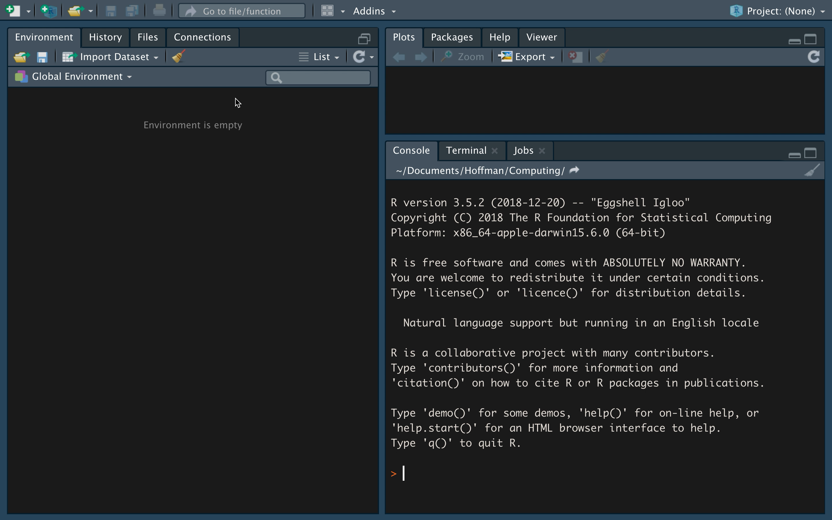
Make an R Project – it’s easy!

Slide 5
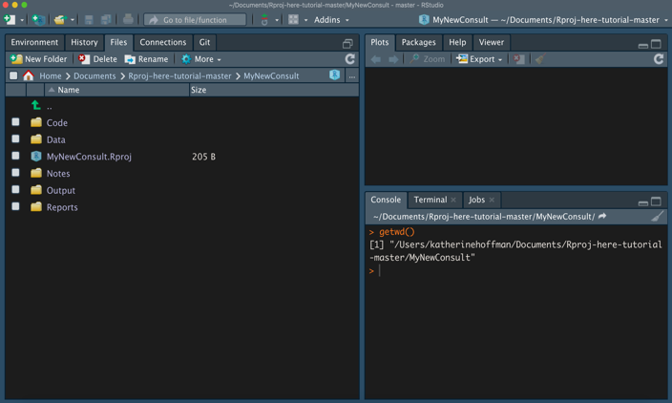
Check your working directory

Slide 6
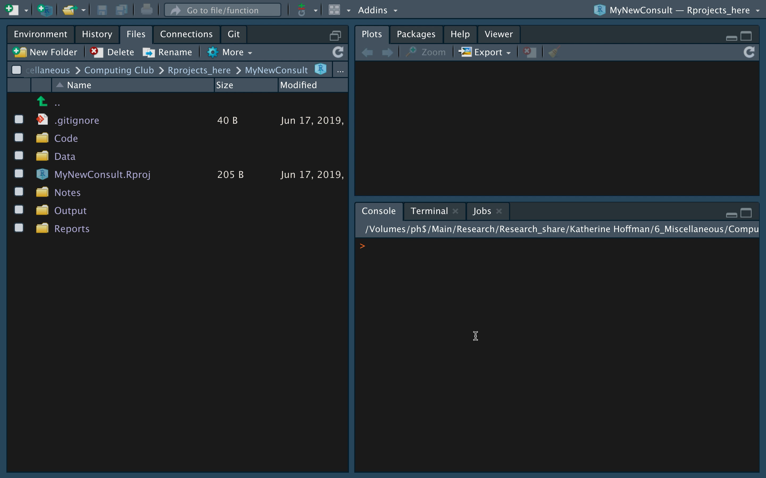
Read and write files

Slide 7

The Beauty of R Projects
Move the folder containing your R Project anywhere
Version control with Git directly in RStudio
Initialize a packrat library
Source: giphy.com

Slide 8

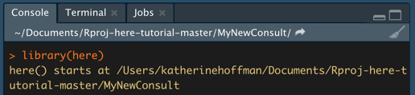
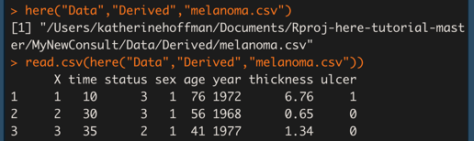
here::here() reminds all your read/write code to work with the R Project’s root directory
Drawing by Allison Horst @allison_horst
Notes:
It’s like a friendly reminder to your code that hey, I set up a project, that’s the path we’re always going to refer to

Slide 9
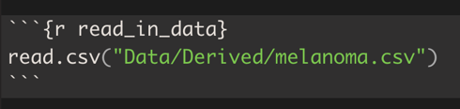
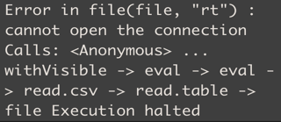
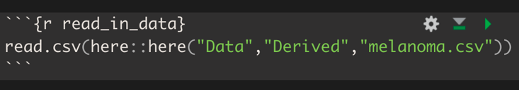
here::here() is especially helpful when using subfolders + Rmarkdown
!
Notes:
45 seconds, switch to screenshots of rmd chunks + messages

Slide 10
Takeaways:
Use R Projects!
Add here::here() around all your read/write files
Notes:
20 seconds until end

Slide 11
Practice
Resources
Interactive codes to try:
https://github.com/hoffmakl/Rproj-here-tutorial
Jenny Bryan’s Project-Oriented workflow tutorial: https://www.tidyverse.org/articles/2017/12/workflow-vs-script/
Jenny Bryan’s here::here() explanation: https://github.com/jennybc/here_here/blob/master/README.md
Malcolm Barrett on why you should use here() in addition to RProjects: https://malco.io/2018/11/05/why-should-i-use-the-here-package/

